Slide 1

EPS Prediction ML Model and Financial Data ETL
Jay Xu

Slide 2


About me
- Recent University At Buffalo graduate with a BS degree in Computer Science
- Form IT Intern at Woodhull Hospital in NYC
- Personal Projects in Full-Stack Web Development
- Interest in Data Engineering
- Being in an innovative environment and challenging myself by building software to simplify the lives of others
- Personal hobbies: Recreational Sports, Traveling, Gaming

Slide 3




Goals for my project
- How can I use Machine Learning to predict earnings per stock (EPS)?
- Use ETL to grab company financial data and display it for data analysis

Slide 4



Datasets Used for Machine Learning and Financial ETL
Datasets used from dolthub.com:
Primary: eps_history.csv (15,000 rows)
Secondary: income_statement.csv (15,000 rows) Goal:
Predict historical EPS and future EPS for each company for each quarter
Extracted variables (columns):
- Company Name
- Quarter Date
- Reported EPS
- Estimated EPS
- Net Income
- Sales (Revenue)
- Average Shares
- Operating Income

Slide 5


Machine Learning Model Used: Gradient Boosted Trees
Extracted variables (columns):
- Company Name
- Quarter Date
- Reported EPS
- Estimated EPS
- Net Income
- Sales (Revenue)
- Average Shares
- Operating Income
1st Tree 2nd Tree 50th Tree
Off by $2.00 Off by $1.00 Off by $0.02

Slide 6
Machine Learning Results EPS Historical Prediction and EPS Future Forecast Click to open Dash

Slide 7

How can I automate / schedule it for future use?
Technologies used for ETL:
How can I extract and transform financial data efficiently?
Where can I store the analyzed data for ease of access?
How do I display it for data analysis?

Slide 8

How can I automate / schedule it for future use? Airflow
Technologies used for ETL:
How can I extract and transform financial data efficiently? Python + PySpark
Where can I store the analyzed data for ease of access? SQL Database
How do I display it for data analysis? Dash

Slide 9
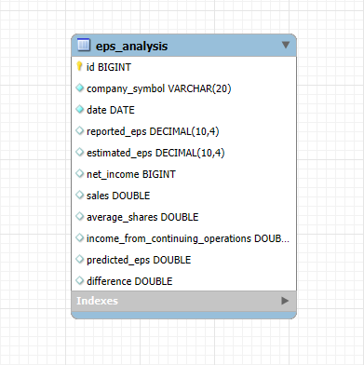
SQL Schema Used for ETL
Extracted variables (columns):
- Company Name
- Quarter Date
- Reported EPS
- Estimated EPS
- Net Income
- Sales (Revenue)
- Average Shares
- Operating Income

Slide 10

ETL Results Company Key Metrics Line Graphs of every companies Net Income, Sales, and Operating Income Multiple Company Comparison Bar Graph comparison of every companies Net Income, Sales, and Operating Income Click to open Dash

Slide 11



Conclusion Machine Learning Model Prediction - Successfully predicted historical EPS and future EPS using Gradient Boosted Trees ETL - Successfully extracted and cleaned data using Python and PySpark - Stored this data for ease of access using SQL - Automated using Airflow for future scheduling of the task - Used dash to display data for analysis github.com/jayxu9000/epsPredictor

